Slide 1

ZEV Mandates:
Concerns & Potential Impacts
David Hermance
Executive Engineer
Environmental Engineering
Toyota Technical Center, USA, Inc.

Slide 2
CA ZEV Mandate - History
Adopted in 1990, a 6 sentence footnote to the LEV regulation
Modified in 1996 to eliminate the 98-02 requirement, <1 full page
Modified in 1998 as part of LEV2 with PZEVs, 6.5 pages as new reg
Overhauled in 2001, currently 20 pages

Slide 3
CA ZEV Mandate - Rqmts
In 1990, 10% ZEV in 2003, with 2% from ‘98-’00 & 5% from ‘01-’02
In 1996, 10% ZEV in 2003, no ramp-up & ‘98-’00 MOAs
In 1998, 4% ZEV in 2003 + 6% PZEV & new credit structure
In 2001, 2% ZEV + 2% ATPZEV + 6% PZEV in 2003 & ramp-up credit

Slide 4
CA Volume Implications
PC + LDT1 - ~1,000,000/yr
LDT2 - ~700,000/yr
LDT2 ramps into program '07-'12
  ZEVs are 0.15-5 credits/vehicle
  ATPZEVs are ~0.5 credits/vehicle, so 2% requires about 4% actual vehicles
  PZEVs are 0.2 credits/vehicle, so 6% requires 30% actual vehicles

Slide 5
ZEV Review Process
Manufacturers submit product plan
ARB visits each manufacturer
2 workshops
BTAP and other contractor reports
Staff report and public meeting
Staff proposal and Board Hearing
Staff modifications per Board

Slide 6
Staff Report (8/00)
Actually a reasonably accurate, but optimistic assessment
Includes cost estimates and emissions benefits
But, does not calculate cost benefit ($1,800,000/ton)
Suggests a market exists, but not without huge subsidies

Slide 7
Battery Panel Assessment
Again, a reasonably complete, but optimistic document
Says Ni-MH is the only viable technology for the next 6 or more years
Shows cost curves that never reach targets
Should be read as dooming EV

Slide 8
Board Direction (9/00)
We have a vision, we want ZEVs
Directed staff to draft a regulation preserving the ZEV program
Meeting had a religious zeal much changed from historic ARB proceedings

Slide 9
Staff Recommended Changes (12/00)
Major reductions in required volumes, new credits games
Accept Grid-HEV as a gold vehicle
Allow a phase-in for PZEVs
Boost EV % requirement in out-years

Slide 10
Board Action (1/25/01)
Redefine the ZEV volume baseline by adding trucks (SUV guilt)
Move grid-HEV to Silver (bad gas)
Double the number of ZEVs from staff recommendation by 2009
Essentially requires a complete re-write of staff’s proposed regulation

Slide 11
Final ARB Action
ARB issued three sets of changes to adopt the Board’s direction
Rational support of technical risk compromised to get more volume
Final package to OAL 12/8/01
OAL rejected 1/28/02 - procedural issues
ARB repairing, due soon

Slide 12
Other ZEV Programs
Vermont is adopting the CA program starting in 2005
New York and Massachusetts have adopted CA program in 2005, but will accept an ACP beginning in 2004
New Jersey has introduced legislation
Others may follow

Slide 13
ZEV Vehicles - Gold
Battery EV
  Highway capable
  City capable
  Neighbor vehicles
Hydrogen Fuel Cell Vehicles

Slide 14

Full Function EV

Slide 15
RAV4-EV - Features
4-door, 5-passenger SUV
NiMH batteries - ~29 kWh, 1000 pounds
Regenerative braking
High efficiency permanent magnet motor
78 mph top speed
80-100 miles real world range
$42,000 MSRP with charger
Favorable lease terms for 36, 48 or 60 months
5 year battery warranty

Slide 16
RAV4-EV Placements
716 in CA, 949 nationwide
Mostly electric utilities and government fleets
Some units at >60,000 miles
Generally positive feedback from customers
Retail availability in CA 02/02
2002 available for sale or lease

Slide 17
Other Full Function EVs
Ford plans limited availability of Ranger EV
No other announcements for 2002

Slide 18
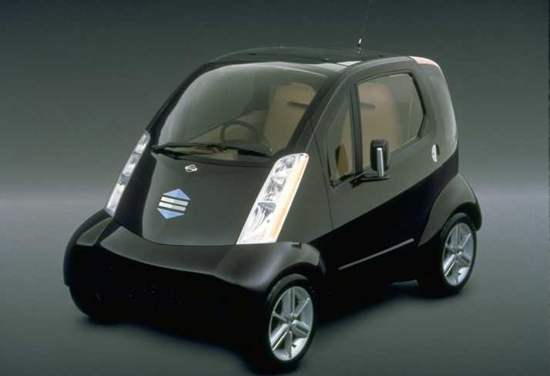

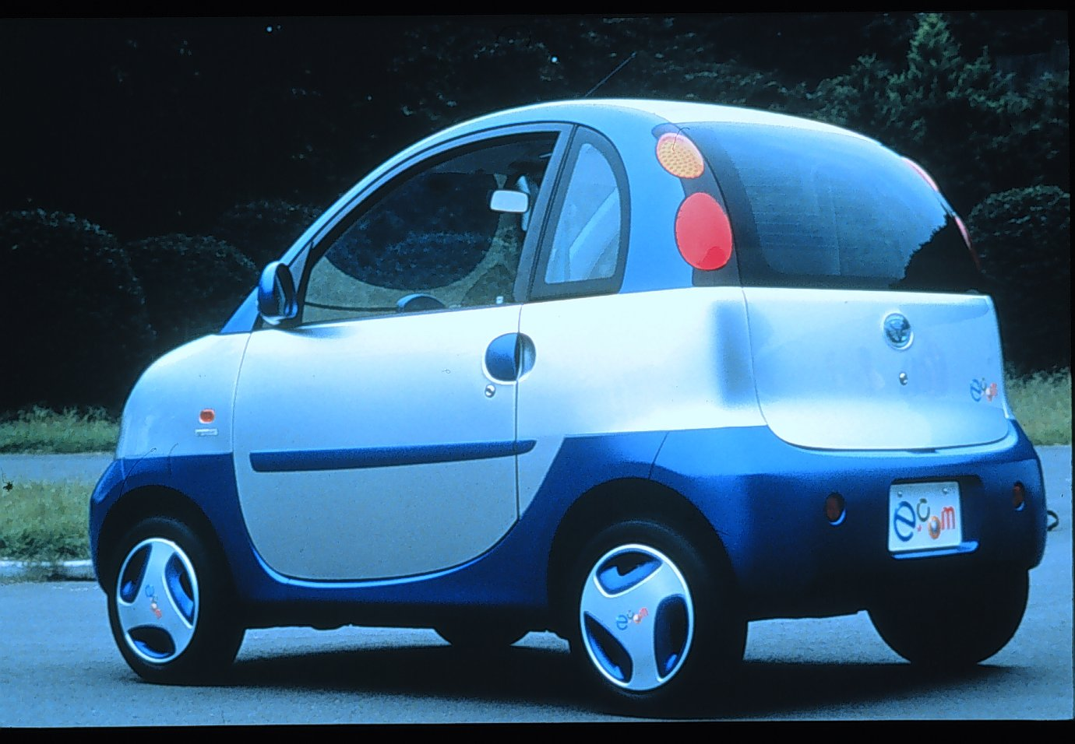
City EVs

Slide 19
(Ford) Th!nk City
2-door, 2-passnger mini-car
Lead-acid batteries - 72 V
Regenerative braking
DC motor
62 mph top speed
50 mile range
US demonstrations with EU vehicles in 2001
$199/mo for 34 months during demo
4th quarter 2002 production availability

Slide 20
Other City EVs
Toyota e-com
  103 worldwide, 15 in CA
  Demonstrations only
  Many demos include ITS
  Ni-MH battery
  No production plan
Nissan Hypermini
  Demonstrations only
  Many demos include ITS
  Li-ion battery
  No production plan

Slide 21
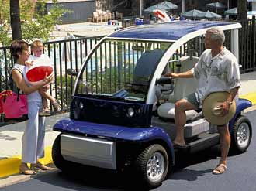
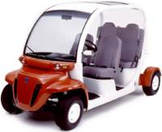
NEVs (LSVs)

Slide 22
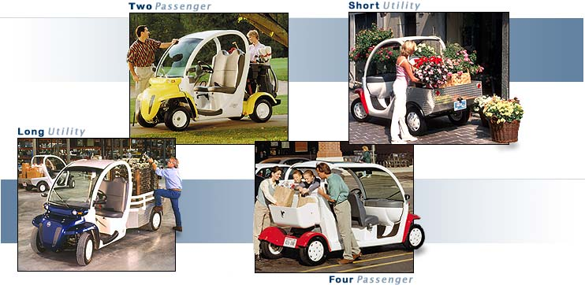
(DCX) GEM NEV
2-passenger and 4-passenger
Lead-acid batteries - 72V
Regenerative braking
25 mph top speed
~7,000 total US sales
$6,995 - $8,995

Slide 23
(Ford) Th!nk Neighbor
2 and 4 passenger models
Lead-acid batteries - 72V
Regenerative braking
25 mph top speed
On sale 4th quarter 2001
$6,500 - $8,000

Slide 24
Other NEVs
Dynasty
Lido
Bombardier

Slide 25
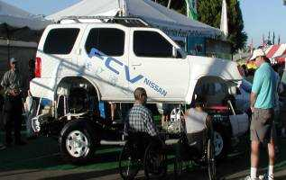



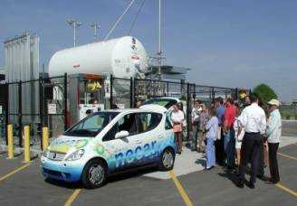
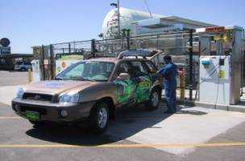

Hydrogen Fuel-Cell Vehicles

Slide 26
H2 FCV - Features
PEM fuel cell - multiple manufacturers
  Ballard
  Toyota
  Honda
  IFC
  GM
H2 storage options
  Hydrogen absorbing alloy fuel storage
  Cryogenic storage
  Compressed gas storage

Slide 27
H2 FCV - Challenges
FC Stack
  power, efficiency, size, cost, durability..
Hydrogen Storage
  capacity, weight, cost, durability..
FC System
  efficiency, size, cost, durability, low temps…
Hydrogen Infrastructure
Regulation, Standardization

Slide 28
ATPZEV Vehicles - Silver
CNG
Hybrids
  Grid independent
  Grid connected
Reformer Fuel Cells

Slide 29
ATPZEV Requirements
SULEV tailpipe emissions (~90% below ULEV)
Zero fuel evaporative emissions
150,000 mile durability
150,000 mile warranty
Full OBD at 1.5*standard
Clean fuel or significant electric drive

Slide 30

CNG

Slide 31
CNG Product Availability
Honda Civic
Ford Crown Victoria
Ford F150 Pick-up
Dodge 2500 Van

Slide 32
CNG - Features
Range of products
CNG storage at 3,000 - 3,600 psi
Generally lower range than gasoline
Issues with CNG refueling infrastructure
Mostly fleet vehicles
Demand is largely driven by EPAct
~$3,000 price premium
Certified as ILEV, HOV eligible

Slide 33

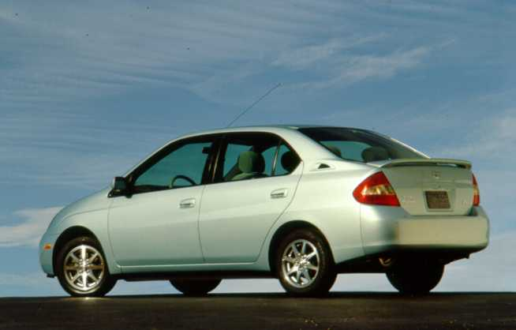
Hybrids

Slide 34
HV Product Announcements
Toyota Prius - On sale 12/97 (Japan), 7/00 (US)
Honda Insight - On sale 12/99
Nissan Tino - On sale 2000 (Japan) limited
Toyota Estima - On sale 6/01 (Japan)
Honda Civic - on sale 12/01 (Japan), 3/02 (US)
Ford Escape - 2003 CY
GM ParadiGM - 2004 MY (Not an ATPZEV)
Dodge Durango - 2004 MY

Slide 35
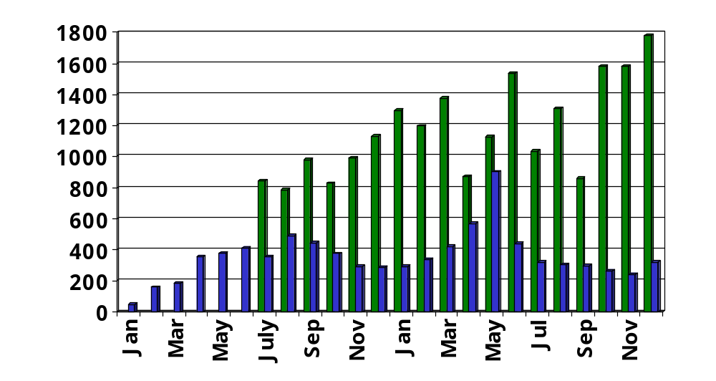
Prius and Insight Sales
Total US Actual Sales
Insight: 8,514 units
Prius: 21,118 units
Toyota Prius
Honda Insight

Slide 36
Prius Attributes
52 mpg - City
45 mpg - Highway
SULEV
0-60 mph ~12.5 seconds
4-door, 5-passenger
More interior space than Corolla
Tight turning circle for city maneuvering
Higher seating position
8 year / 100,000 mile hybrid system warranty
$19,995 + shipping

Slide 37
Insight Attributes
ULEV Manual Transmission
  61 City
  68 Highway
SULEV CVT
  57 City
  56 Highway
All Aluminum Body
3 year / 36,000 mile hybrid system warranty
$21,280 w/CVT and A/C

Slide 38

Reformer Fuel-Cell Vehicles

Slide 39
PZEV Vehicles - Bronze
SULEV tailpipe emissions
Zero evaporative emissions
150,000 durability demonstration
150,000 mile warranty
Full OBD @ 1.5*standard

Slide 40
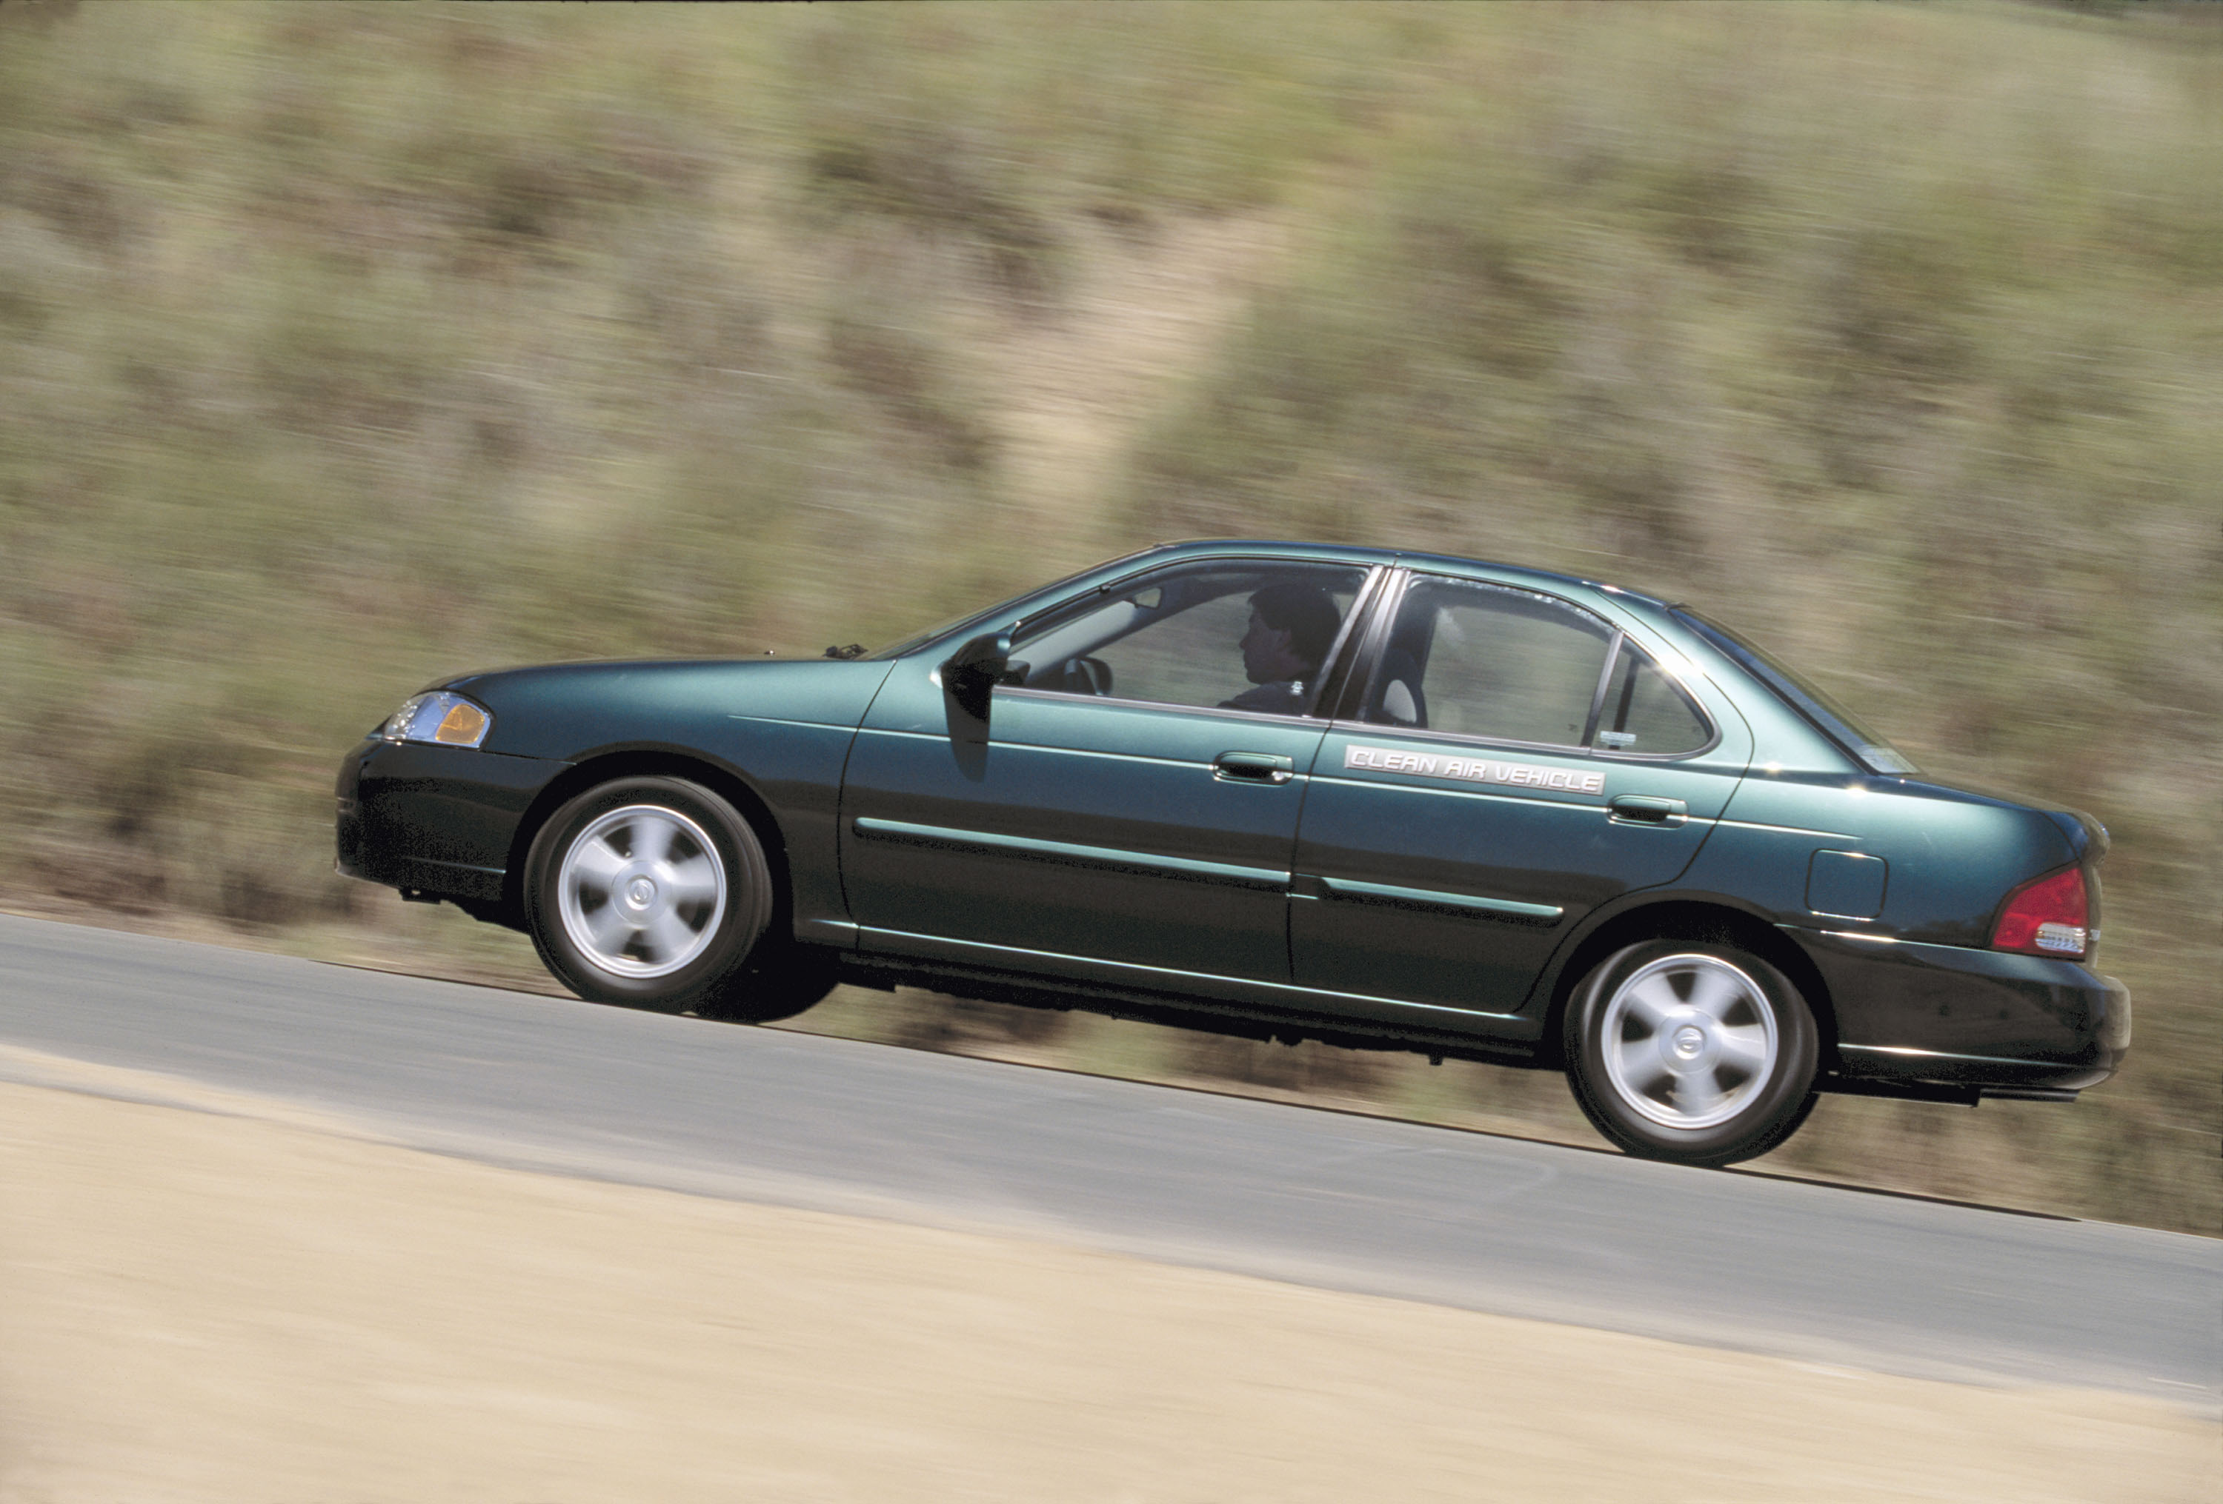
Gasoline PZEV

Slide 41
PZEV Challenges
SULEV tailpipe emissions
  New catalysts, more precious metal
  Cold start driveability issues
Zero evaporative emissions
  New systems and materials
  Packaging issues
150,000 durability demonstration
150,000 mile warranty
  Possible cost increases
Full OBD @ 1.5*standard
  Seriously diminishing returns

